Slide 1
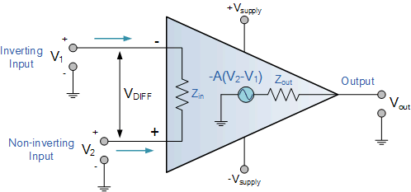

CO2015 Operational Amplifier (Op-Amp)

Slide 2
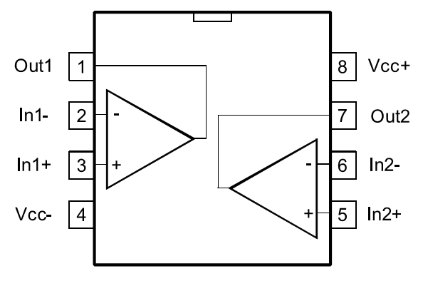
Contents
Operation
Feedback Circuit
Characteristics
Practical Applications

Slide 3
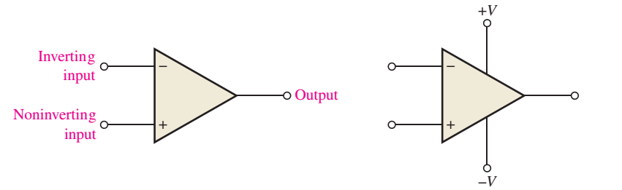
Basic Op-Amp
Op-Amp = Operational Amplifier
An Op-Amp consist
Inverting input
Noninverting input
Output
Two power supply pins (V+ and V-)

Slide 4
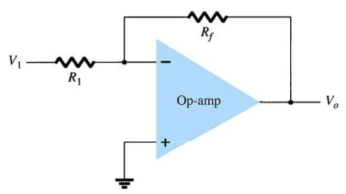
Op-Amp Gain
Op-Amps have a very high gain. They can be connected open-loop or close-loop.
Open-loop refers a configuration where there is no feedback from output back to the input. In the open-loop configuration, the gain can exceed 10⁵.
Closed-loop configuration reduces the gain. In order to control the gain of an op-amp it must have feedback. This feedback is a negative feedback. A negative feedback reduces the gain and improves many characteristics of the op-amp.

Slide 5
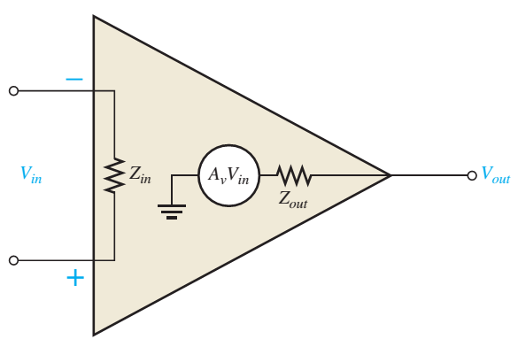
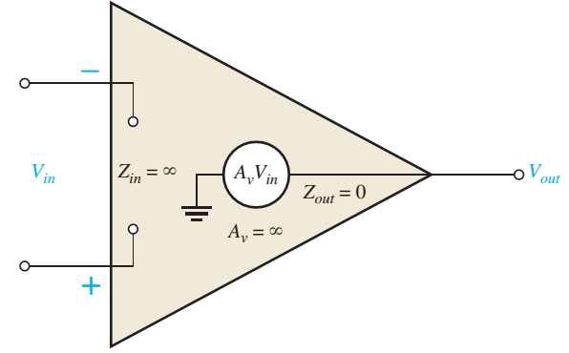
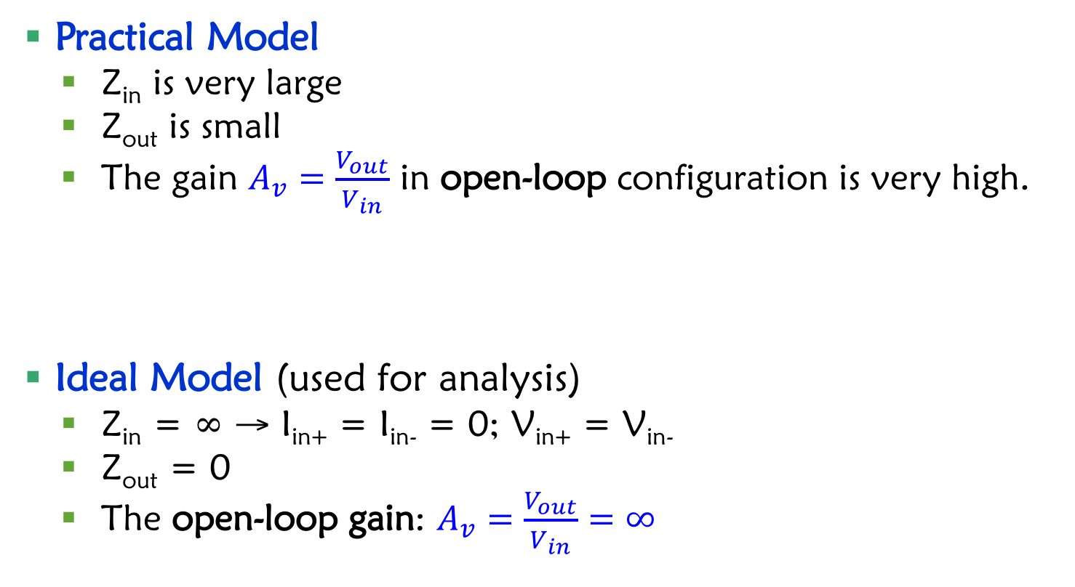
Op-Amp Models
Practical Model
Z_{in} is very large
Z_{out} is small
The gain $A_{v}=\frac{V_{out}}{V_{in}}$ in open-loop configuration is very high.
Ideal Model (used for analysis)
Z_{in} = ∞ → I_{in+} = I_{in-} = 0; V_{in+} = V_{in-}
Z_{out} = 0
The open-loop gain: $A_{v}=\frac{V_{out}}{V_{in}}=∞$

Slide 6
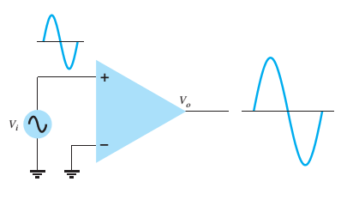
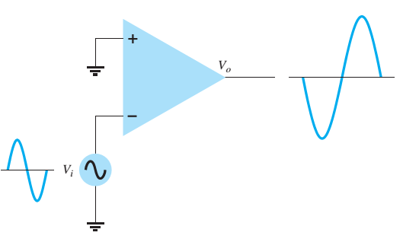
Operation of Op-Amp
The amplitude of V_{out} is higer than amplitude of V_{in}.
Same phase
Inversed phase
Notes:
The output is the amplifier of the difference between V+ and V-

Slide 7
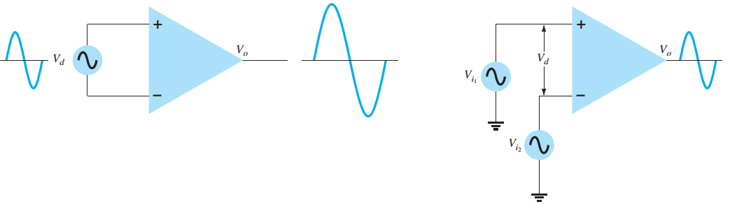
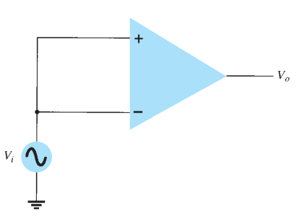
Operation of Op-Amp (cont)
The differential signal of 2 inputs is amplified.
When 2 inputs use common signal, the output is zero.

Slide 8
Real Op-Amp Models
A_{cm}: Common Amplifier

Slide 9
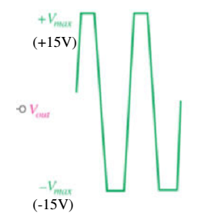
Non Feedback Circuits (Open Loop)
For the circuits without feedback (i.e. no connection between output and input), the open-loop gain is very large (>10⁵).
The output voltage will easily reach the saturation and the amplitude will be trimmed.

Slide 10
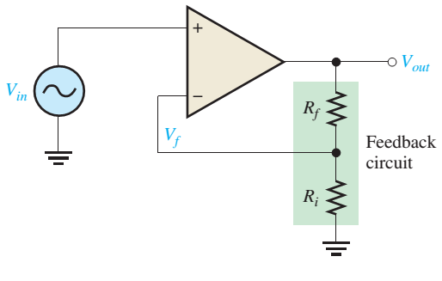
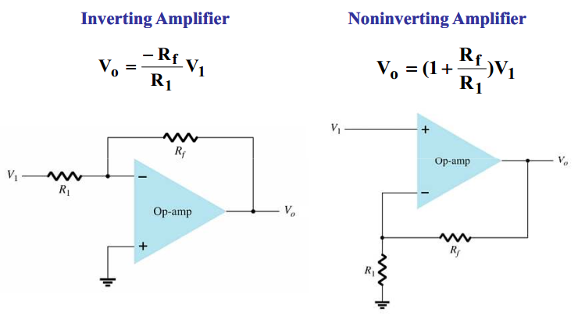
Negative Feedback Circuits (Close Loop)
In order to control the gain of an op-amp it must have feedback. This feedback is a negative feedback. A negative feedback reduces the gain and improves many characteristics of the op-amp.

Slide 11


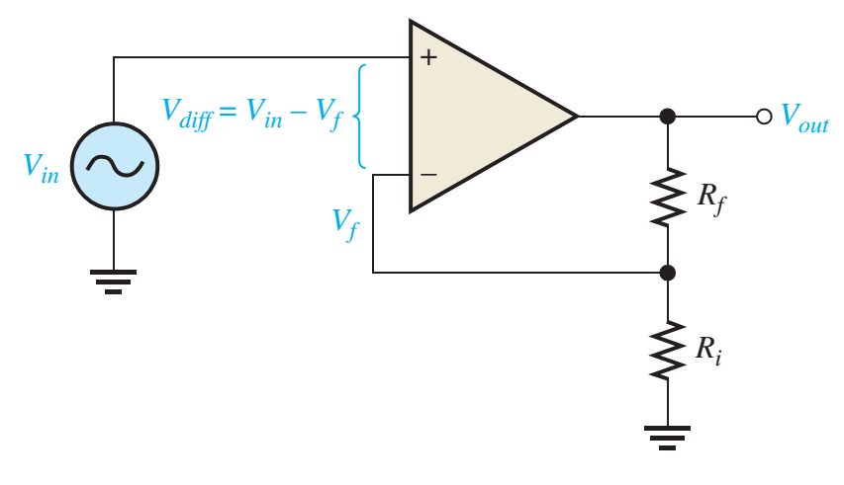



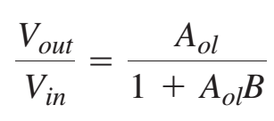
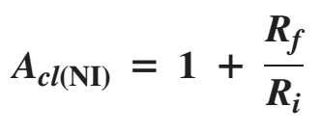
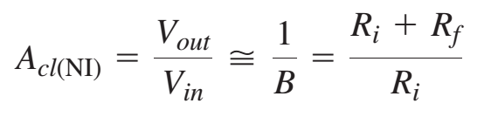
Negative Feedback

Slide 12
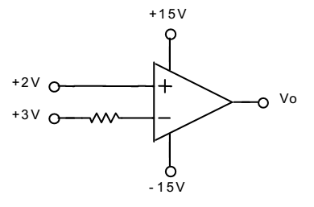
Exercise 1
Characteristics of an Op-Amp is given in the following table. The power supply is ±15V.
Determine V_{o}
Parameter | Minimum | Typical | Maximum
Output Voltage | ±12V | ±13.5V
Input Voltage | ±11V | ±12.5V
Output current of shorted-circuit | ±12mA | ±20mA

Slide 13
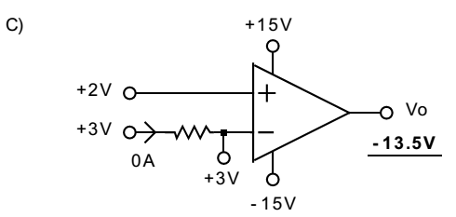
Exercise 1 - Solution

Slide 14
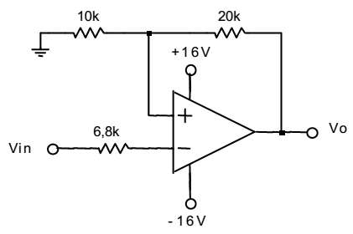
Exercise 2
Characteristics of an Op-Amp is given in the following table. The power supply is ±15V.
Determine V_{o} when V_{in}=±6V
Parameter | Minimum | Typical | Maximum
Output Voltage | ±12V | ±13.5V
Input Voltage | ±11V | ±12.5V
Output current of shorted-circuit | ±12mA | ±20mA

Slide 15
Exercise 2 - Solution

Slide 16
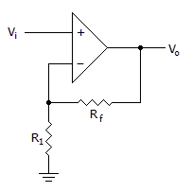
Exercise
Calculate the output gain of the circuit if R1 = 100(Ohm) and Rf = 1(KOhm)

Slide 17
Answer
11

Slide 18
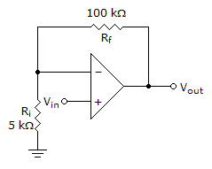
Refer to the given figure. A dc input signal of –50 mV is applied. You would measure ________ from the inverting input to ground.
50mV
1.05V
-1.05V
-50mV

Slide 19
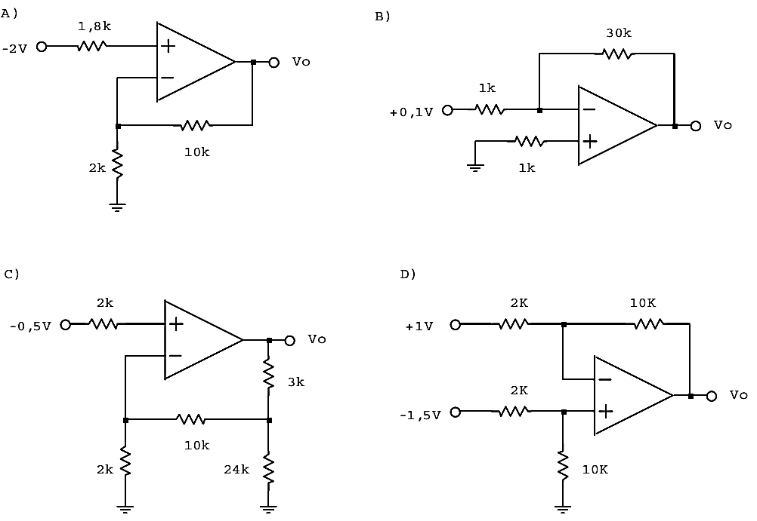
Exercise
Compute the output voltage in the following circuits using ideal op-amp

Slide 20
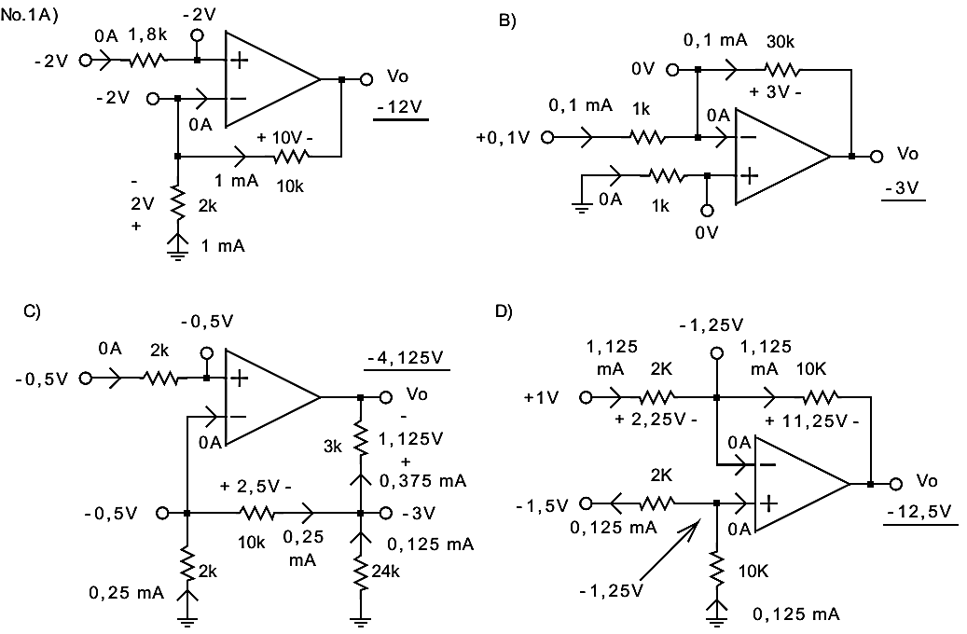
Solution

Slide 21
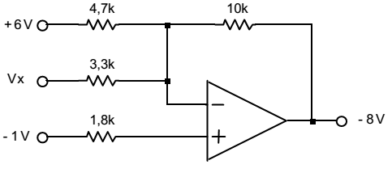
Exercise
Characteristics of an Op-Amp is given in the following table. The power supply is ±15V.
Determine V_{X}
Parameter | Minimum | Typical | Maximum
Output Voltage | ±12V | ±13.5V
Input Voltage | ±11V | ±12.5V
Output current of shorted-circuit | ±12mA | ±20mA

Slide 22
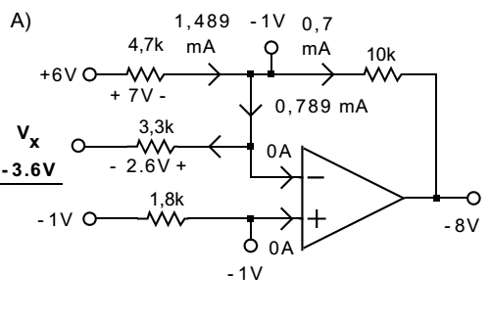
Solution

Slide 23
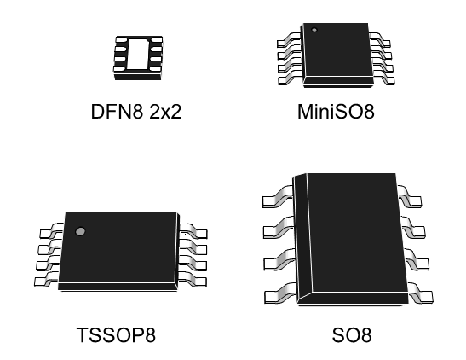
Op-Amp Datasheet
IC LM358

Slide 24
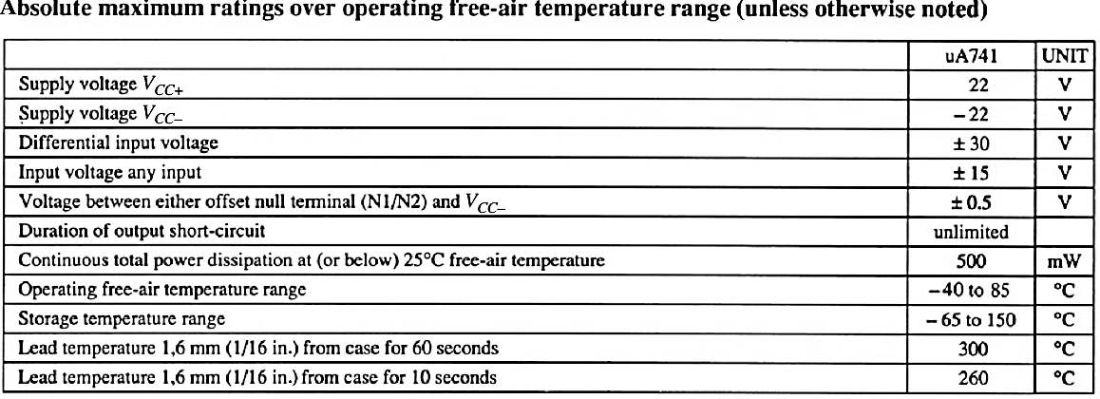
Op-Amp Datasheet (IC LM358)
Maximum power supply: ±22V
Maximum input voltage: ±15V
Maximum differential input voltage: ±30V

Slide 25
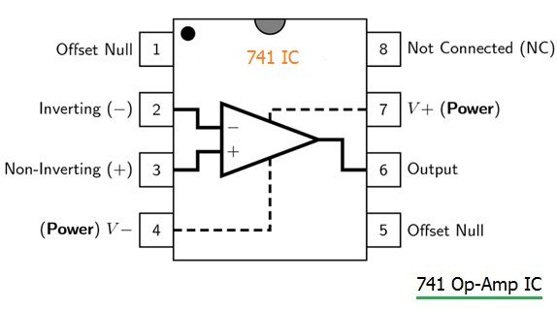
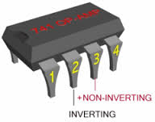
Op-Amp Datasheet
IC 741

Slide 26
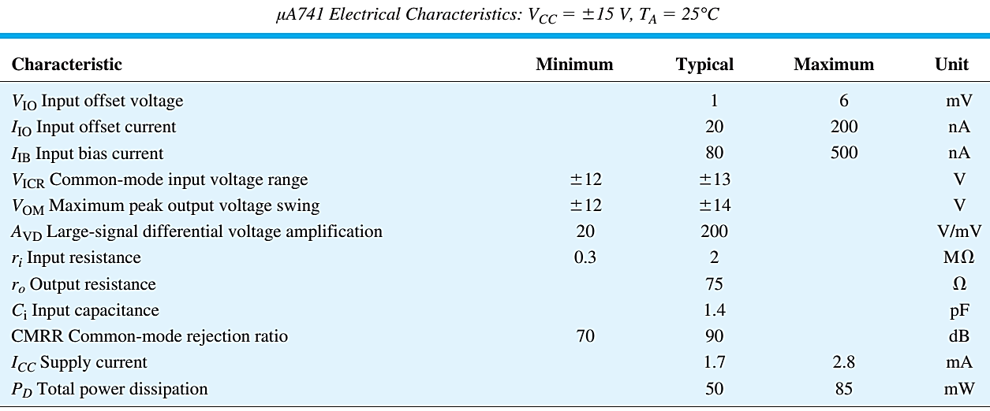
Op-Amp Datasheet (μA741)
Điện thế hoạt động 3 đến 30 → nếu nguồn đôi là ±15V
Điện thế ngõ vào từ (Vcc-) – 0.3 đến (Vcc+) – 1.5
A_{VD} – Large-signal differential voltage amplification
200V/mV = 200.000
r_{i} – input resistance: 2MΩ
r_{o} – output resistance: 75Ω

Slide 27
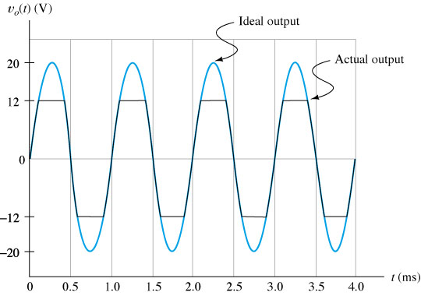
Output Voltage Threshold

Slide 28
Practical Op-Amp Circuits
Voltage Follower or Voltage Buffer or Unity Follower
Summing Amplifier
Integrator (Low pass filter)
Differentiator (High pass filter)
Comparator

Slide 29
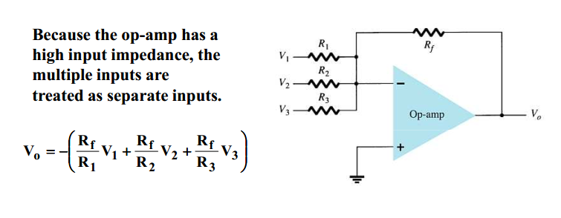
Summing Amplifier

Slide 30
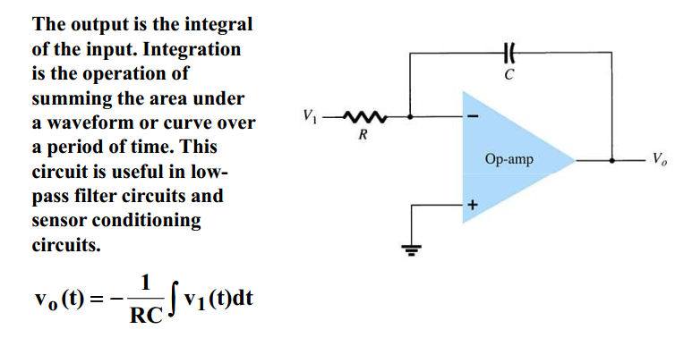
Integrator

Slide 31
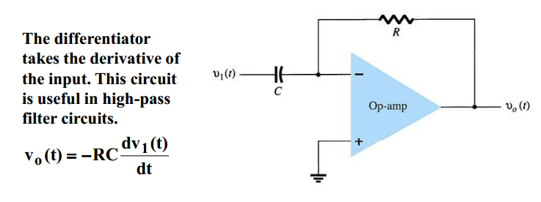
Differentiator

Slide 32
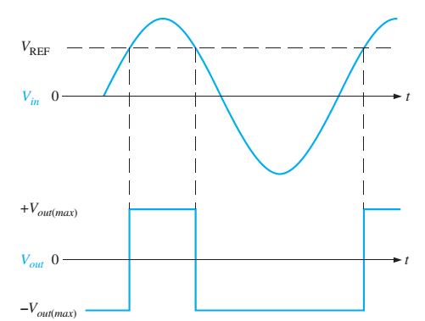
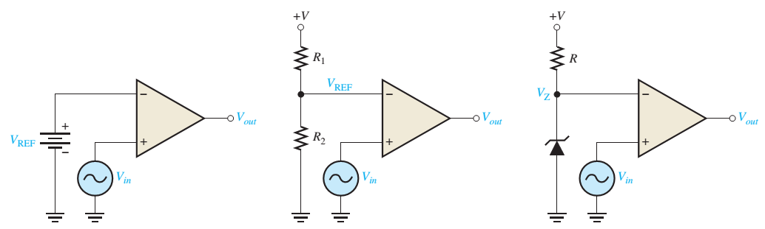
Comparator
V_{out} = +V_{out(max)} when V+ > V-
V_{in} > V_{REF}
V_{out} = -V_{out(max)} when V+ < V-
V_{in} < V_{REF}

Slide 33
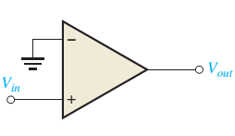
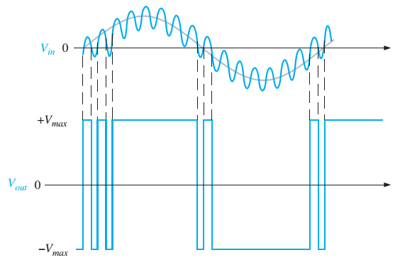
Noisy Comparator
Unexpected pulses

Slide 34
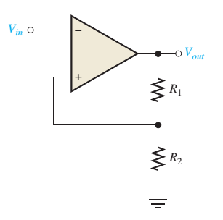


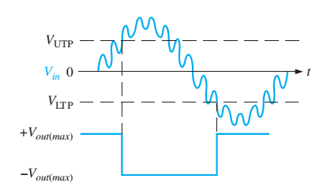

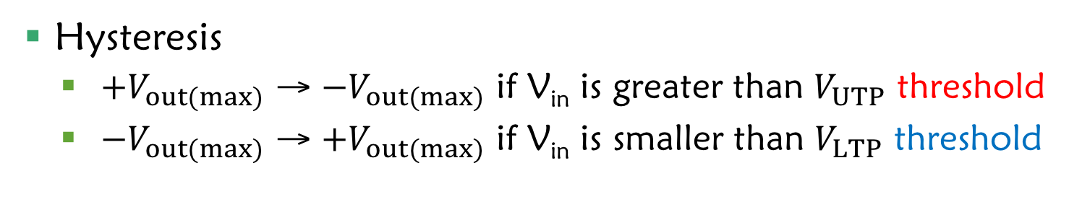
Noiseless Comparator
Hysteresis
${+V}_{out(max)}$ → ${−V}_{out(max)}$ if V_{in} is greater than $V_{UTP}$ threshold
${−V}_{out(max)}$ → ${+V}_{out(max)}$ if V_{in} is smaller than $V_{LTP}$ threshold

Slide 35
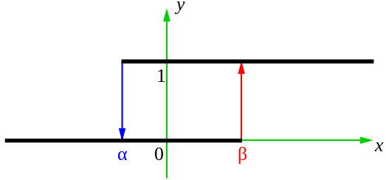
Noiseless Comparator
Hysteresis
0 →1 if V_{in} is greater than β threshold
1 → 0 if V_{in} is smaller than α threshold

Slide 36
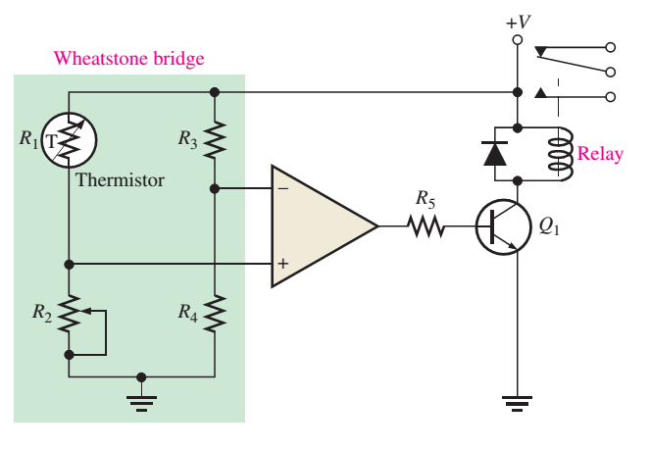
Application (1)
Protection Circuit using Op-Amp Comparator

Slide 37
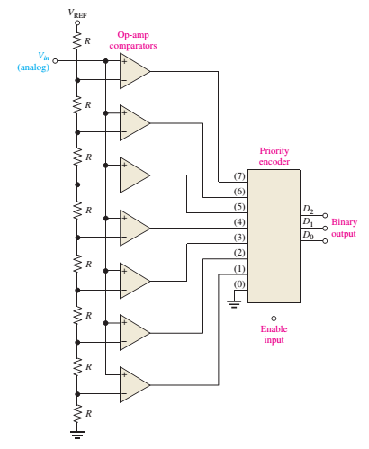
Application (2)
Analog to Digital Conversion

Slide 38
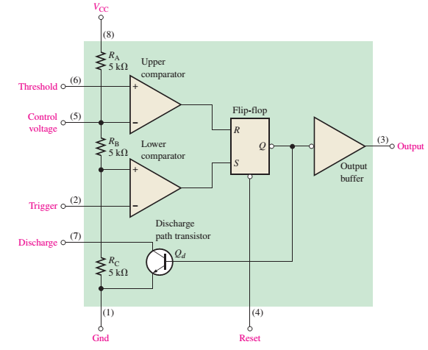
IC 555

Slide 39
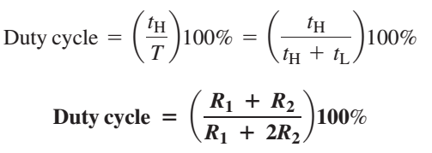
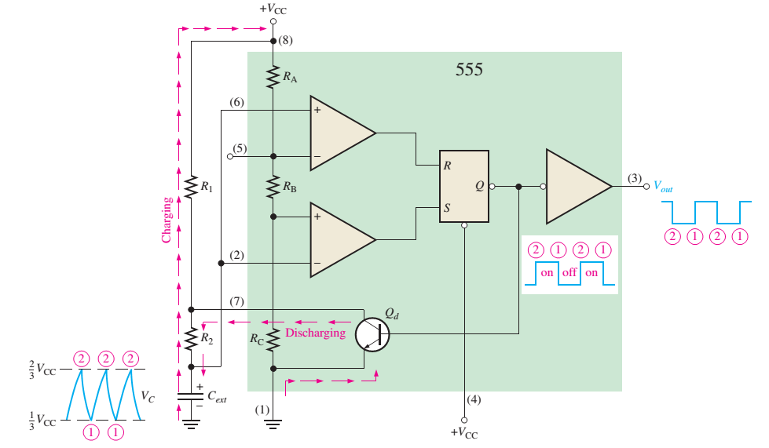


IC555 – Clock Pulse Generator

Slide 40
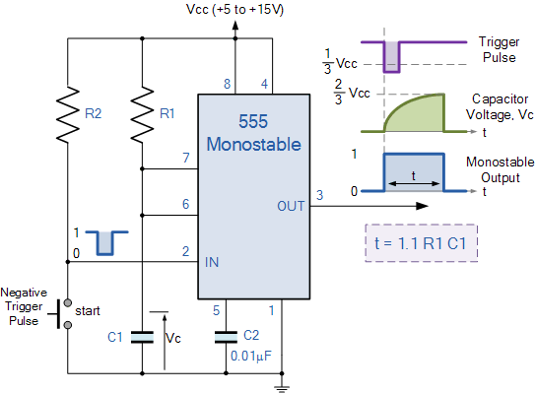
IC555 – Delay Circuit

Slide 41

Calculate the input voltage if the final output is 10.08 V
0.168V

Slide 42
Bài 3: Đáp án câu A và C
Vo = Av(2-3) = - (âm)
Av rất lớn nên Vo sẽ bị xén ở điện thế ngõ ra nhỏ nhất
Vo = V-(sat) = -13.5V

